Slide 1
Nervous System

Slide 2
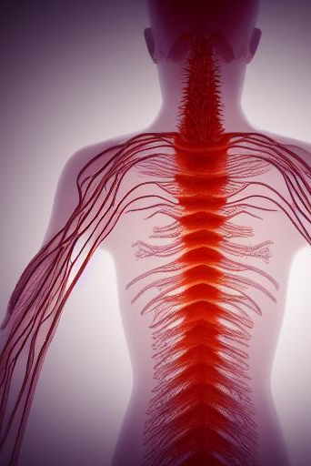
Nervous System
The nervous system is a complex network of cells, tissues, and organs that work together to control all bodily functions. It is divided into two main parts: the central nervous system (CNS) and the peripheral nervous system (PNS).

Slide 3
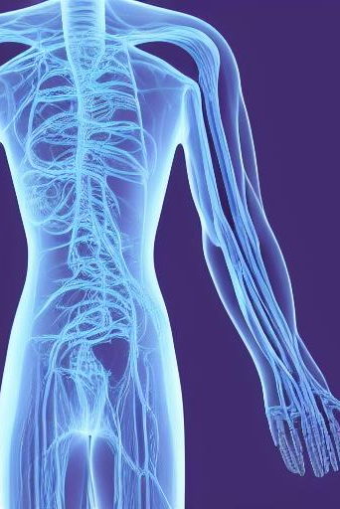
Central Nervous System (CNS)
The CNS consists of the brain and spinal cord. The brain is the main control center of the body, responsible for processing information, making decisions, and controlling movement. The spinal cord is a long, thin bundle of nerves that runs from the brain down the back. It carries messages between the brain and the rest of the body.

Slide 4
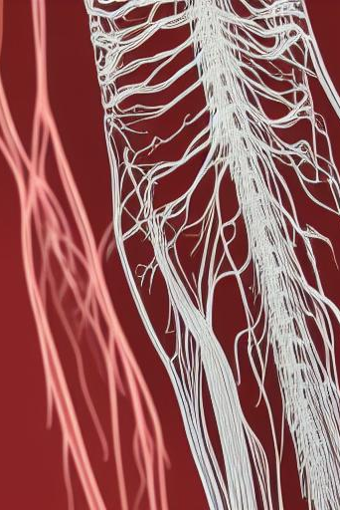
Peripheral Nervous System (PNS)
The PNS consists of all the nerves that connect the CNS to the rest of the body. The PNS is divided into two parts: the somatic nervous system and the autonomic nervous system.

Slide 5
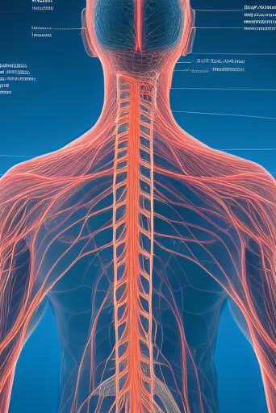
Somatic Nervous System
The somatic nervous system controls voluntary movements, such as walking, talking, and writing. It also receives sensory information from the skin, muscles, and joints.

Slide 6
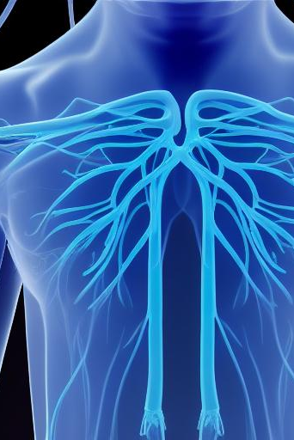
Autonomic Nervous System
The autonomic nervous system controls involuntary functions, such as breathing, heart rate, and digestion. It is divided into two parts: the sympathetic nervous system and the parasympathetic nervous system.

Slide 7
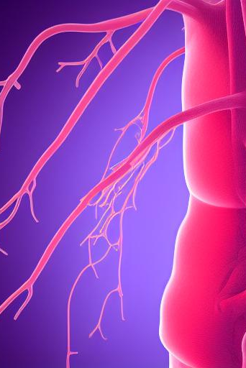
Sympathetic Nervous System
The sympathetic nervous system prepares the body for action. It increases heart rate, blood pressure, and respiration. It also dilates the pupils and relaxes the bladder.

Slide 8
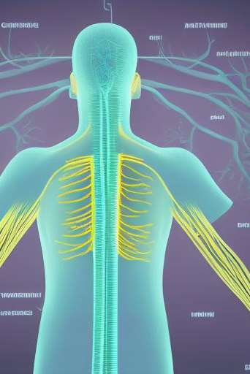
Parasympathetic Nervous System
The parasympathetic nervous system calms the body down. It decreases heart rate, blood pressure, and respiration. It also constricts the pupils and contracts the bladder.

Slide 9
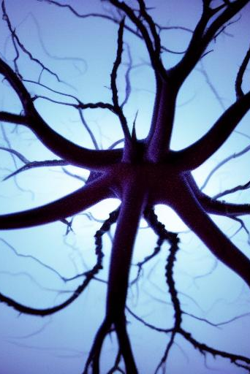
Neurons
Neurons are the basic units of the nervous system. They are specialized cells that transmit information throughout the body. Neurons have three main parts: the cell body, the dendrites, and the axon.

Slide 10
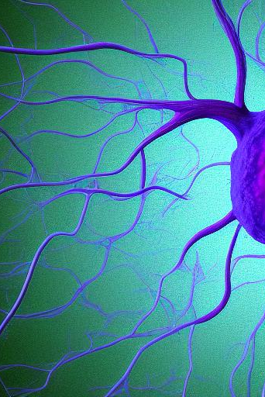
Cell Body
The cell body is the main part of the neuron. It contains the nucleus, which controls the cell's activities.

Slide 11
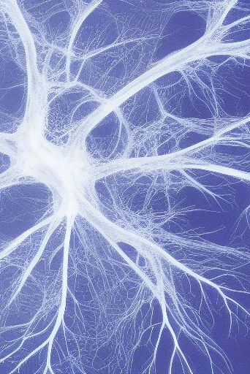
Dendrites
Dendrites are short, branching extensions of the cell body. They receive signals from other neurons.

Slide 12
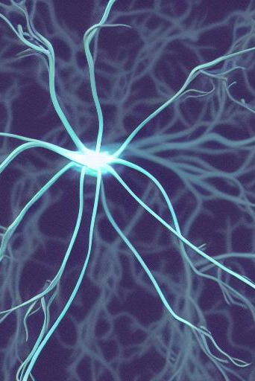
Axon
The axon is a long, thin extension of the cell body. It transmits signals to other neurons.

Slide 13
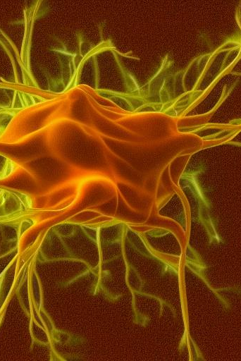
Synapse
A synapse is a junction between two neurons. When an electrical signal reaches the end of an axon, it triggers the release of neurotransmitters. Neurotransmitters are chemical messengers that cross the synapse and bind to receptors on the dendrites of the next neuron.

Slide 14
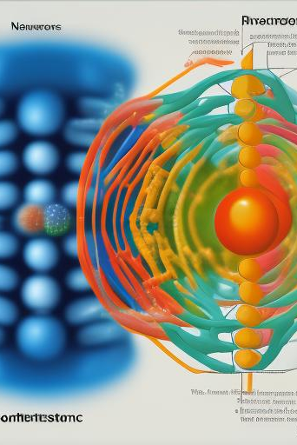
Neurotransmitters
Neurotransmitters are chemicals that transmit signals between neurons. There are many different types of neurotransmitters, each with its own unique function. Some of the most common neurotransmitters include dopamine, serotonin, and norepinephrine.

Slide 15
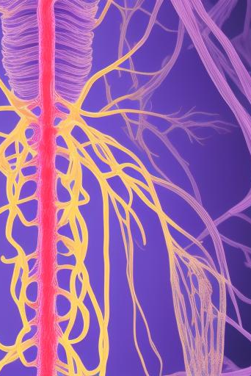
Nervous System Disorders
There are many different types of nervous system disorders. Some of the most common include Alzheimer's disease, Parkinson's disease, and multiple sclerosis.

Slide 16
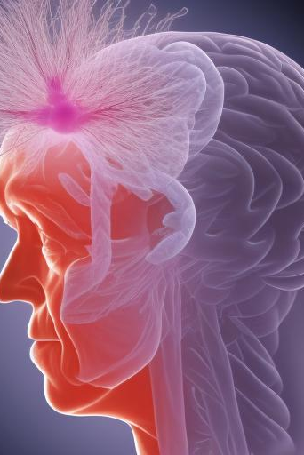
Alzheimer's Disease
Alzheimer's disease is a progressive neurological disorder that affects memory, thinking, and behavior. It is the most common type of dementia.

Slide 17
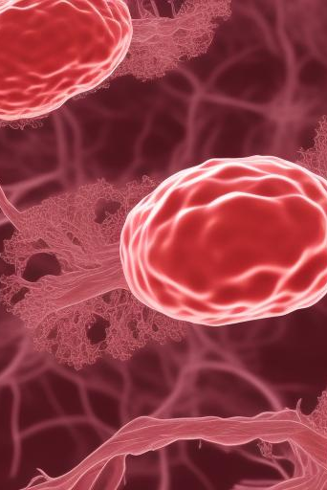
Parkinson's Disease
Parkinson's disease is a progressive neurological disorder that affects movement. It is characterized by tremors, rigidity, and slowness of movement.

Slide 18
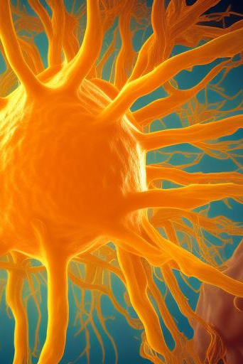
Multiple Sclerosis
Multiple sclerosis is a chronic neurological disorder that affects the brain and spinal cord. It causes damage to the myelin sheath, which insulates the nerves.

Slide 19
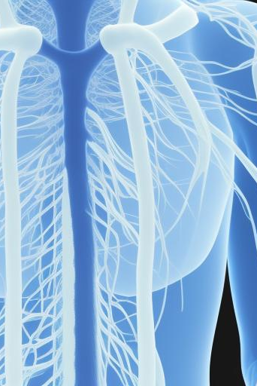
Treatment for Nervous System Disorders
There is no cure for most nervous system disorders. However, there are treatments that can help to manage the symptoms and improve quality of life.

Slide 20
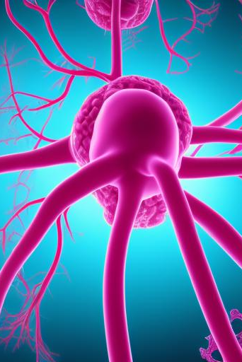
Prevention of Nervous System Disorders
There is no sure way to prevent nervous system disorders. However, there are some things you can do to reduce your risk, such as eating a healthy diet, getting regular exercise, and avoiding smoking and excessive alcohol consumption.

Slide 21
Conclusion
The nervous system is a complex and fascinating system that plays a vital role in our everyday lives. By understanding how the nervous system works, we can better appreciate its importance and take steps to protect it from damage.

